Slide 1

Automated Parking
Lot System
A smart microcontroller-based entry and exit gate management solution powered by ATmega32 AVR.
Team Team 4 — Embedded_Elite
Supervisor Eng. Hesham Ahmed
Microcontroller ATmega32 (8-Bit AVR @ 8MHz)
Course Embedded Systems Diploma

Slide 2












System Concept & Simple Workflow
Car Arrives
Check Spots
Enter PIN
Gate Opens
Log & Close
Vehicle triggers the entry sensor (External Interrupt INT0).
System checks if available parking spaces > 0 on LCD.
Driver enters admin security passcode via 4x4 Keypad.
Timer1 PWM moves Servo Motor to 90° for entry.
Counter updates, UART logs event, gate safely closes.
Key System Logic
If the parking lot reaches maximum capacity (Full), the Red LED illuminates, LCD displays "PARKING FULL", and entry requests are instantly rejected until a car exits (INT1 trigger).

Slide 3




Layered Software Architecture
APP Layer
HAL Layer
MCAL Layer
High-level business logic controlling state transitions:
Hardware Abstraction Drivers for peripherals:
Direct register-level AVR peripheral drivers:
•
DIO Driver (Digital Inputs/Outputs)
•
Parking Manager State Machine
•
LCD 16x2 Display Driver
•
EXTI Driver (External Interrupts)
•
Spot Counter & Vehicle Manager
•
4x4 Matrix Keypad Driver
•
TIMER1 Driver (16-bit Fast PWM)
•
Security Password Verification
•
SG90 Servo Motor Driver
•
UART Driver (Serial Logging)
•
LED & Button Drivers
Includes Modular Common Utilities: STD_TYPES.h, BIT_MATH.h, and Common_Macros.h.

Slide 4



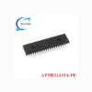
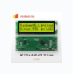




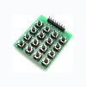
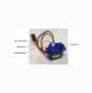
Main Hardware Components
ATmega32 MCU
LCD Display 16x2
Main 8-bit AVR microcontroller running at 8MHz, executing core logic & peripheral timing.
Real-time user interface showing available parking spots, system status & passcode prompts.
4x4 Matrix Keypad
SG90 Servo Motors
Security passcode input for driver authentication & admin system maintenance mode.
Controls physical entry & exit gate barriers via Timer1 Fast PWM signal generation.

Slide 5

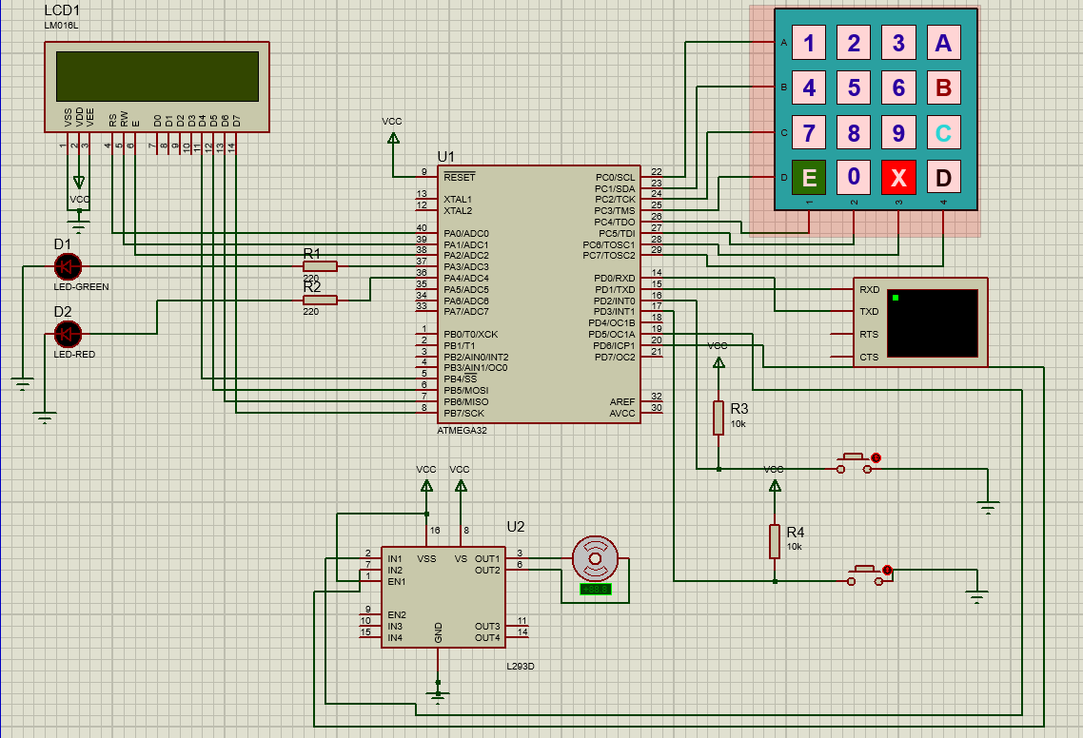
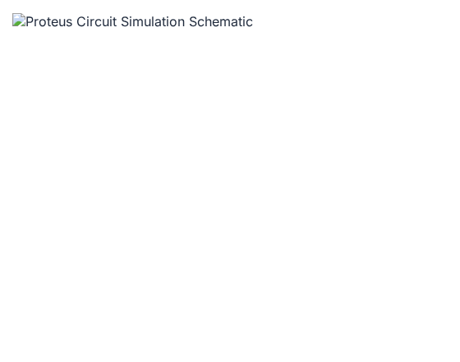

Proteus Schematic Simulation
Pin Interfacing
•
PORTA (PA0-PA7): LCD 8-bit Data Bus
•
PORTB (PB0-PB2): LCD Control (RS, RW, EN)
•
PORTC (PC0-PC7): 4x4 Matrix Keypad Rows/Cols
•
PORTD (PD2, PD3): Entry (INT0) & Exit (INT1) Sensors
•
PORTD (PD5, PD6): Timer1 PWM Servo Gates
•
PORTD (PD0, PD1): UART Virtual Terminal

Slide 6



Member Work: Abdulrahman Ali Abdelaziz
Abdulrahman Ali Abdelaziz Ali
TEAM LEADER & MCAL/HAL DEVELOPER
Key Project Contributions
Project Architecture & APP Layer: Designed overall state machine logic (INIT, IDLE, ENTRY, EXIT, FULL, ADMIN).
DIO Driver: Implemented low-level Digital Input/Output port manipulation functions.
Keypad Driver: Developed matrix scan routine for security passcode verification.
Integration & Testing: Led GitHub repository management, Proteus simulation assembly, and hardware debugging.
LCD Driver: Wrote 16x2 character LCD driver in 8-bit mode for displaying live counter & user messages.
Discusses: System Architecture, State Machine & Keypad Security Logic

Slide 7


Member Work: Yousef Mohamed Al-Sayed
Yousef Mohamed Al-Sayed Abohashem
MCAL / HAL DEVELOPER
Key Project Contributions
EXTI Driver: Configured External Interrupts (INT0, INT1) for instant vehicle detection without blocking MCU execution.
LED Driver: Developed visual status indicators (Green for Space Available, Red for Parking Full).
APP Layer Support: Assisted in vehicle entry/exit counter calculations & condition checking.
Hardware Simulation: Validated interrupt edge triggers and LED state toggles in Proteus.
Discusses: External Interrupts (INT0/INT1), LED Indicators & Vehicle Sensing

Slide 8


Member Work: Omar Hamdy Hamed
Omar Hamdy Hamed Abdelrahman
HAL & COMMUNICATION DEVELOPER
Key Project Contributions
UART Driver: Implemented serial communication driver to transmit real-time system log events to Virtual Terminal.
Event Logging: Configured event strings (e.g., "ENTRY GATE OPENED", "PARKING FULL").
Presentation: Co-created presentation materials and system documentation.
Discusses: LCD Display Interface & Real-time UART Event Logging

Slide 9

Member Work: Omar Alaa Eldin
Omar Alaa Eldin Abdelrady
MCAL DEVELOPER
Key Project Contributions
Timer1 MCAL Driver: Programmed ATmega32 16-bit Timer1 peripheral in Fast PWM Mode (Mode 14).
PWM Generation: Generated precise 50Hz PWM signals required for standard servo motor positioning.
Prescaler & ICR1 Setup: Calculated exact ICR1 top value for 20ms period (50Hz) at 8MHz clock frequency.
Presentation: Co-created technical slides and hardware timing diagrams.
Discusses: 16-bit Timer1, Fast PWM Generation & Timing Calculations

Slide 10

Member Work: Mina Ramy Rizk
Mina Ramy Rizk Youssef
HAL DEVELOPER & SIMULATION ENGINEER
Key Project Contributions
Servo Motor HAL Driver: Created high-level API functions SERVO_voidSetAngle() mapping 0° to 180° angles.
Gate Motion Logic: Calibrated Duty Cycle pulse widths (1ms for 0° closed, 1.5ms for 90° open).
Proteus Simulation: Designed and tested servo motor response during entry and exit gate routines.
Presentation: Contributed to presentation visual materials and system demonstration.
Discusses: SG90 Servo Actuation & Gate Angle Duty Cycle Mapping

Slide 11

Thank You!
The Automated Parking Lot System successfully demonstrates modular layered software architecture and real-time embedded control on ATmega32.
Embedded_Elite
ATmega32 AVR
Questions & Discussion

